Slide 1
COVID-19 Epidemiology Update – 7 Aug 2020
Ministry of Health

Slide 2
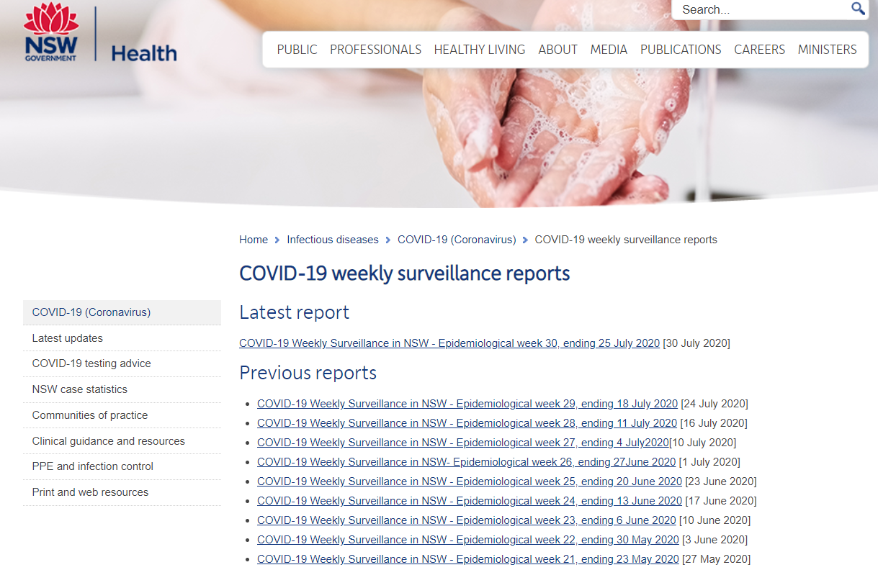
COVID-19 weekly surveillance report
Each week a detailed surveillance report is published on the NSW Health website
Each edition features a specific focus using NSW COVID-19 data.
https://www.health.nsw.gov.au/Infectious/covid-19/Pages/weekly-report.aspx

Slide 3
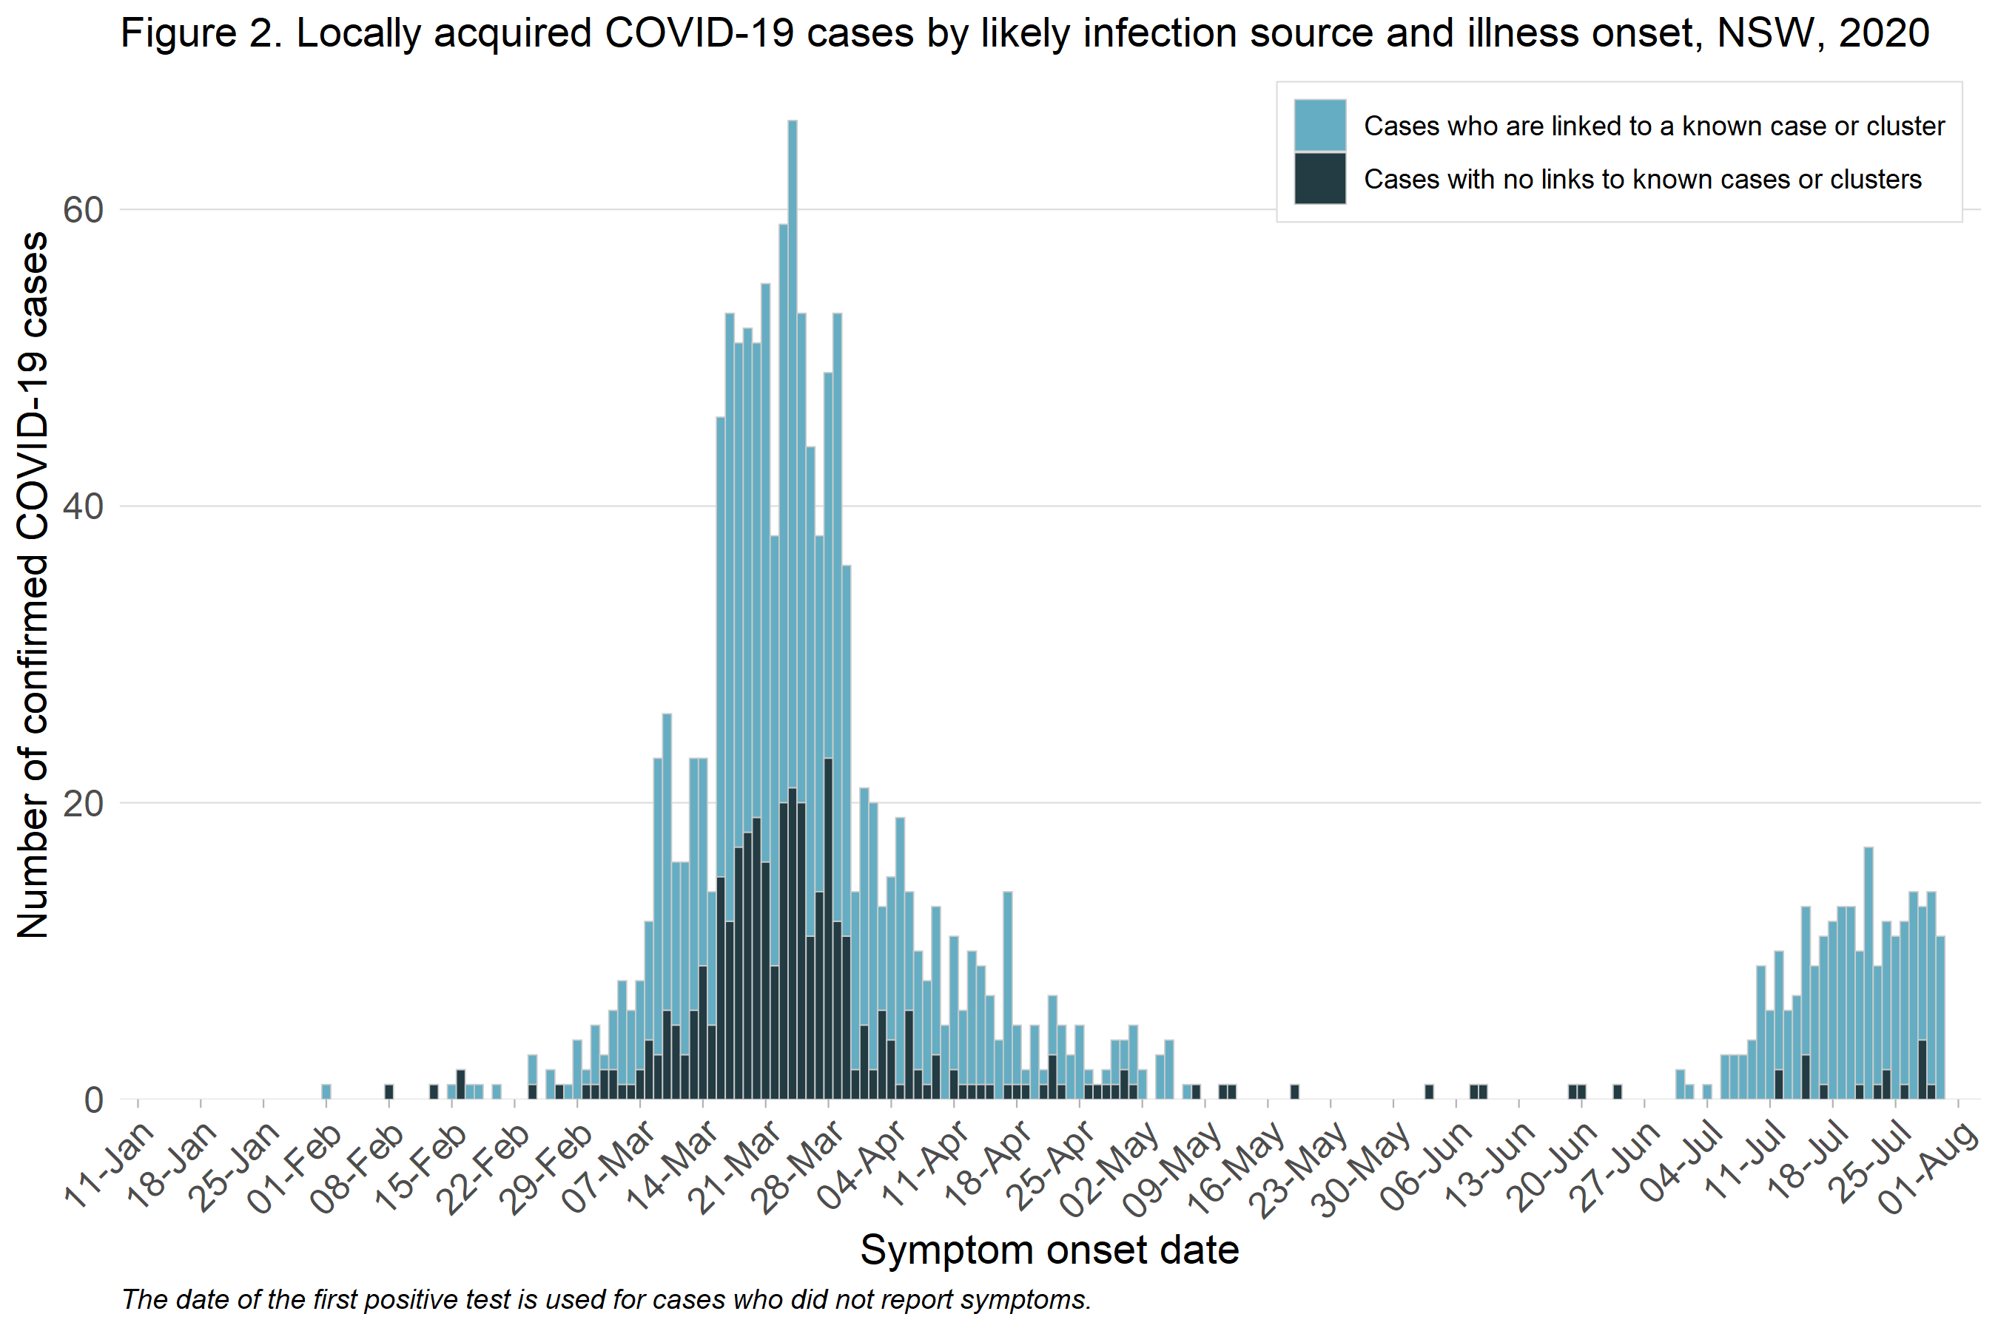
Locally acquired COVID-19 cases by onset of illness per day
There has been a refresh of COVID-19 data available on the NSW Health website.
https://www.health.nsw.gov.au/Infectious/covid-19/Pages/recent-case-updates.aspx
Source: COVID-19 Weekly surveillance report
Epidemiological week 31, ending 1 Aug 2020
Notes:
Interpretation: Larger clusters occurred in NSW before many of the strict social distancing rules
were introduced. Since this time, there has been a decline in both the COVID-19 cases known to have
had contact with a confirmed case or who are part of a cluster and those with an unknown source.
The number and size of clusters will be closely monitored as changes to social distancing rules are
implemented.

Slide 4
Number of PCR tests per day
Source: COVID-19 Weekly surveillance report
Epidemiological week 31, ending 1 Aug 2020
Notes:
Interpretation: COVID-19 testing increased significantly in April and early May in line with the changes
in the criteria for testing and increased availability of testing. Early in the outbreak the focus was on
returning travellers whereas now testing is now recommended for anyone with even mild respiratory
symptoms or unexplained fever.
The cumulative testing rate in NSW continues to remain high at 56 tests per 1,000 population (NSW
cases = 3,085). While there is variation with countries reporting significantly more cases over longer
periods of time, the rates of testing in NSW are similar to rates reported in New Zealand (52 per 1,000;
1,154 cases), the UK (49 per 1,000; 257,154 cases) and Singapore (50 per 1,000; 31,068 cases).

Slide 5
Proportion of tests positive for COVID-19
Source: COVID-19 Weekly surveillance report
Epidemiological week 31, ending 1 Aug 2020
Notes:
Interpretation: The number of people diagnosed and proportion of tests positive for COVID-19 in NSW declined since mid-March to early May, and has stabilised at very low levels since, despite the high rates of testing. This suggests there is currently limited transmission in the community.
High rates of testing are critically important to identify and isolate people who are infectious and to allow contact tracing (quarantining of all people potentially infected by a case) to limit the spread of infection.
Testing is not recommended for those without symptoms except in special settings when case have been identified such as aged care, health care, disability homes and schools.

Slide 6
Rapid response to COVID-19 cases in sensitive or high-risk settings

Slide 7
Response to COVID-19 cases - overview
The current objectives of outbreak management for COVID-19 in NSW are:
Identify cases early
Identify and manage close contacts
Stop transmission
Track source of infection
We have an aggressive response to cases occurring in high risk settings such as schools, aged care facilities, workplaces and vulnerable workers.
Testing of asymptomatic contacts may be recommended to inform management of an outbreak.
New case
COVID-19
Infection source ?
Infectious period
Incubation period
14 days
prior
48 hours
prior

Slide 8
NSW Health capabilities to respond to community clusters or clusters in sensitive settings (eg schools, residential aged care facilities, workplaces)
Ability to increase testing in the community through strategies such as pop-up testing centres, working with local GPs and Aboriginal Community Controlled Health Services; expansion of capacity in existing COVID-19 clinics
In-reach capacity to establish testing onsite in facilities such as residential aged care facilities
Sufficient capacity to isolate cases, contact trace and identify contacts and quarantine them (greater than 250 cases per day, assuming an average of 15 close contacts per case)
Communication strategies to message the need for testing and enhanced compliance with public health measures (supported by PIFAC and Service NSW)
Increased compliance checks of COVID-safe practices at venues/settings in local communities

Slide 9
Contact tracing capacity
Local health districts can contact trace 220 cases a day statewide (assuming 15 close contacts each, over 20 weeks, including weekends) ¹
The Ministry of Health has additional capacity:
Current Surge capacity = 300 contact tracers/day with capacity to contact trace 55 cases/day¹
Additional Surge
Support from partner agencies:
Department of Primary Industries
Public Service Commission
Service NSW
Australian Defence Force
Australian Commission on Safety and Quality in Health Care
Technological assistance (WHISPIR platform = monitoring text sent to close contacts in quarantine); Prodocom – mass SMS/email system
¹Assuming availability of contact details; success on first call attempt; non complex cases

Slide 10
Outbreak plans have been developed for high risk settings
Incident Action Plans developed by NSW Health:
Universities and TAFE
Group homes (disability)
School aged children, teachers & early childhood settings
Aged care facilities
Justice Health (correctional facilities)
Social Housing settings (in development)
National guidance (CDNA) that would apply in NSW:
Residential care facilities
Aboriginal and Torres Strait Islander communities
Correctional and Detention Facilities
Workplaces – including remote industrial sites
NSW Health is working with the Department of Primary Industries, SafeWork NSW and NSW Food Authority to develop tools to support abattoirs and other high-risk workplace settings.

