Slide 1
SHS Client Satisfaction Survey
Results 2020

Slide 2
What is the Client Satisfaction Survey?
Annual sector- wide survey run by CHIA and the IP
All SHS in NSW are invited to participate
Measures:
Client demographics
Clients’ current situation and wellbeing
Clients’ experience and satisfaction with services
The impact of service on client outcomes

Slide 3
How was the Survey Run?
Services implemented the survey between March and April, and October and November 2020
Client participation was voluntary and required their informed consent
Survey was available online or via an app.
Clients could complete on their own or with assistance

Slide 4
Response Rates
35 services participated
501 clients participated
Most were from regional or rural NSW

Slide 5
Demographics
69% Female
30% Aboriginal or Torres Strait Islander
51% 25 years or less
43% with a disability
39% one or more children
Notes:
Represents demographics of respondents – not necessarily of all clients across NSW

Slide 6
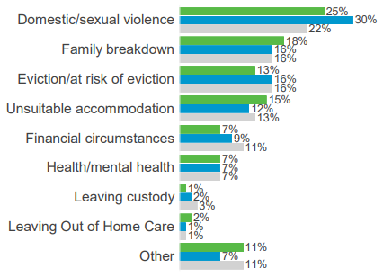
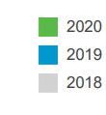
Reason Seeking Support
DFV was the most common reason for seeking support
The % who reported that DFV as the reason for seeking support was less than in 2019
Notes:
Decrease in % seeking assistance because of DFV may be due to COVID-19 impact on how DFV services supported clients and increased risk to safety

Slide 7
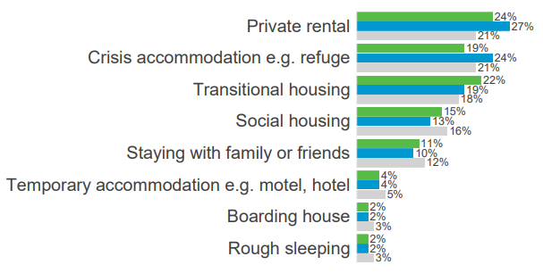
Current Situation
Private rental was the most common types of accommodation
Followed by transitional housing and crisis accommodation

Slide 8
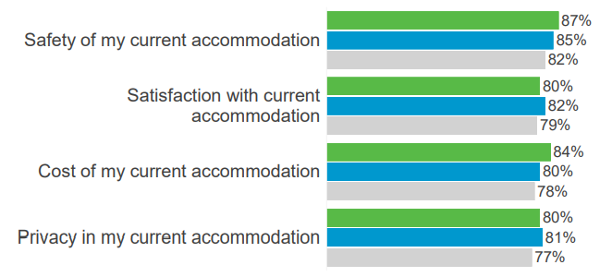
Satisfaction with Accommodation
80% were satisfied with their current accommodation overall
Notes:
No statistically significant changes

Slide 9
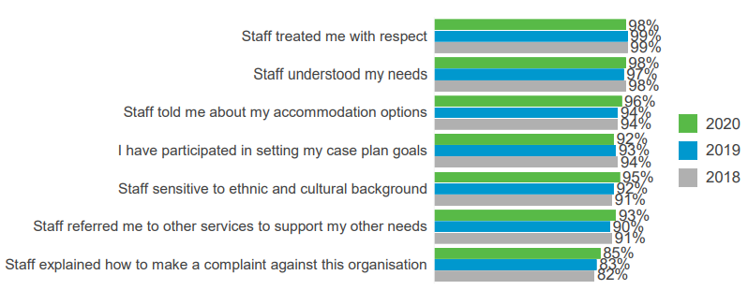
Satisfaction with Service
Overall, 96% of clients reported that they are satisfied with the services provided
Notes:
No statistically significant changes
“staff understood my needs” and “staff treated me with respect” were significant predictors of overall satisfaction

Slide 10
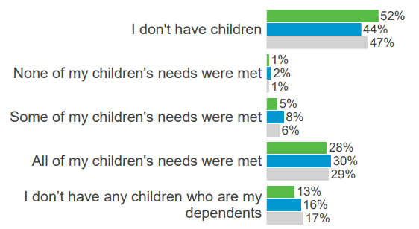
Meeting Children’s Needs
Most clients with dependent children reported that their children’s needs were met
Notes:
82%

Slide 11
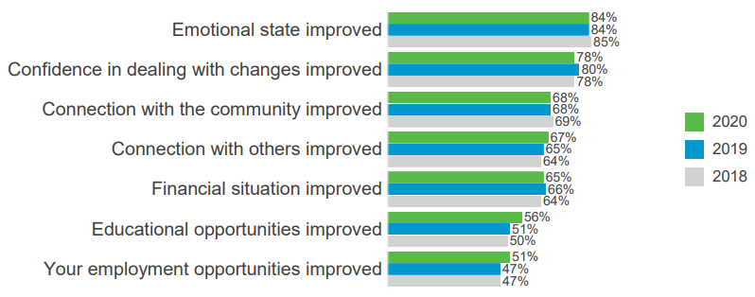
Impact of Service
Improved emotional state is the most reported impact of service
Notes:
No statistically significant changes
Those aged 21-25 were significantly more likely to report that their emotional state has improved (91%) than those aged 16-20 (79%) and those aged 61+ (72%).
Interesting that half reported employment opportunities improved – despite recession.
Clients of youth specialist service were more likely to report improved employment opportunities (62%) than clients of generalist homelessness services (49%) or DFV services (37%).
Those in Youth and Generalist SHS were significantly more likely than those in DFV to report that their financial situation has improved.
There was a statistically significant fall in the proportion of clients from for DFV services that reported improved financial situtations (from 67% in 2019 to 54%).

Slide 12
Wellbeing Index
Average PWI was 67.4
Australian average was 76.4 in 2020
70+: ‘normal’
51-69: ‘challenged’
<50: ‘high risk’
Notes:
Clients in private rental have the highest PWI score (72.4), while those sleeping rough have a score of just 47.5.

Slide 13
Human Service Outcomes Framework Domains Scores
Economic
60%
⇧ 4
Health
63%
⇧ 5
Education
56%
⇧ 5
Safety
Home
Community
69%
⇧ 1
80%
⇧ 1
63%
⇧ 2
Empowerment
71%
⇧ 1
Notes:
Weighted composite scores
All scores higher than last year

Slide 14
Keen to be part of the 2021 Survey?
Registrations are open until this Friday 19 March
Go to https://www.surveymonkey.com/r/DRQHBB6
SHS with10 or more clients who participate in the survey will get a report with their service's results
Got questions?
Email sectorsupport@homelessnessnsw.org.au

